Slide 1

EE4404 Project
The Utilization of Shared Energy Storage in Energy Systems
A Comprehensive Review
Group member：
Wu Shuye
Kan Ziyang
Wu Junxi
Liao Yiming
U2401022
U2401026
U2401029
U2401115

Slide 2

CONTENTS
Introduction
Modeling and optimization of energy storage sharing
01
05
Background and significance
Literature Classification
02
06
Energy storage sharing architecture
Future Research Directions
03
07
Realization of shared energy storage
Summary
04
08

Slide 3

Introduction
● According:
Today, our group will give a presentation on the application of shared energy storage (SES) in energy systems. Our report is based on the paper which written by Rui Dai, Rasul Esmaeilbeigi and Hadi Charkhgard, and published in IEEE TRANSACTIONS ON SMART GRID.
The article mainly introduces the concept, architecture, implementation, modeling and optimization methods of shared energy storage, classifies and compares related literature, and explores future research directions.
LED

Slide 4
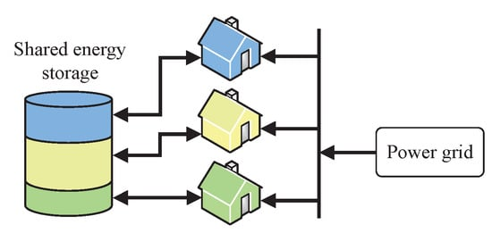
Background and significance
● Background:
Energy storage plays an important role in modern smart grids and energy systems. It can improve system efficiency and resilience, achieve energy arbitrage, and ensure stable power generation from renewable energy.

Slide 5
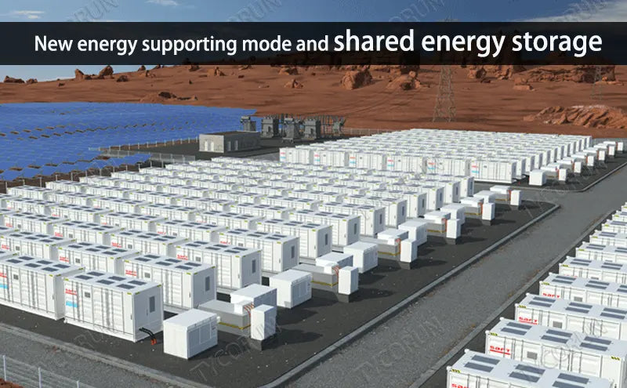
Background and significance
● Background:
However, it faces challenges in system framework design and management strategy development. Shared energy storage has attracted attention due to the increase in energy exchange in energy systems. It can overcome the limitations of traditional energy storage utilization frameworks and bring new economic opportunities.

Slide 6
Background and significance
● Scope of the study:
Concepts related to energy storage sharing are explained, including users, capacity sharing and storage energy sharing, implementation methods of shared energy storage (direct and indirect), fairness and efficiency, etc.

Slide 7
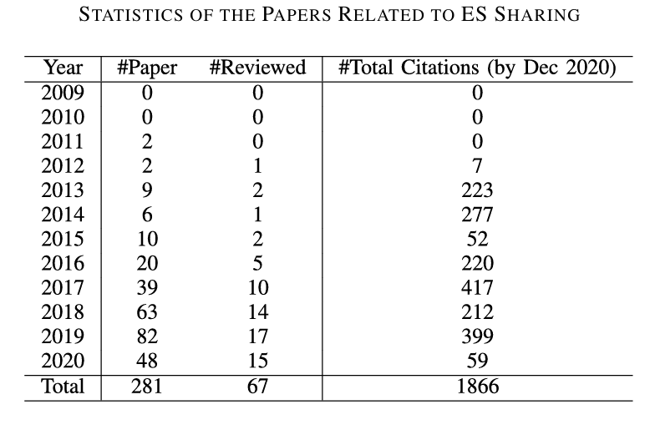
Background and significance
● Literature collection method:
Through the Scopus database, specific keywords were used to search for papers related to shared energy storage in the past ten years. After screening, 281 papers were obtained, of which 67 were related to direct energy storage sharing. This paper mainly reviews these papers.

Slide 8
Background and significance
● Contributions and outline:
Systematically review the research on shared energy storage, classify the shared energy storage architecture and explain the advantages and disadvantages, review and classify related papers from multiple aspects, point out the gaps in the literature and provide research directions.

Slide 9
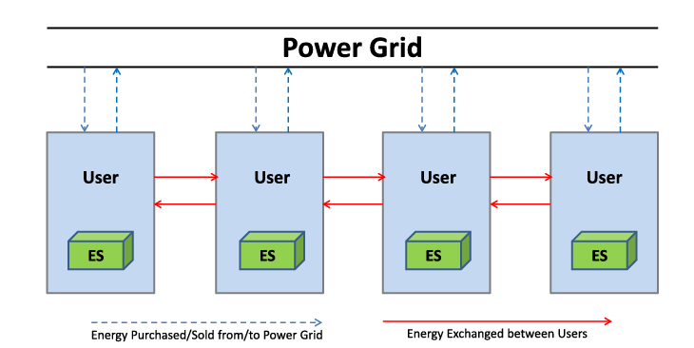
Energy storage sharing architecture
● Private energy storage:
Each user owns and independently operates energy storage, which is the mainstream framework for energy trading and sharing systems, but there are problems such as cost inefficiency and difficulty in determining the scale of energy storage.

Slide 10
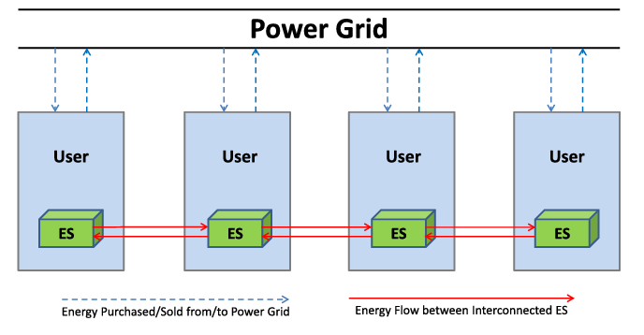
Energy storage sharing architecture
● Interconnected energy storage:
Capacity sharing is achieved through interconnected users’ energy storage, and the storage capacity can be adjusted, but there are still cost issues in the distributed framework, and the management strategy focuses on incentive mechanisms.

Slide 11
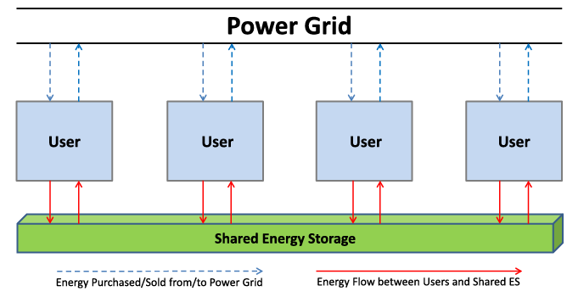
Energy storage sharing architecture
● Public energy storage:
Installing a shared energy storage for all users is the mainstream architecture, such as community energy storage. Operational strategies include allocating capacity to allow users to operate independently or coordinated and managed by aggregators, involving capacity allocation and storage energy allocation issues.

Slide 12
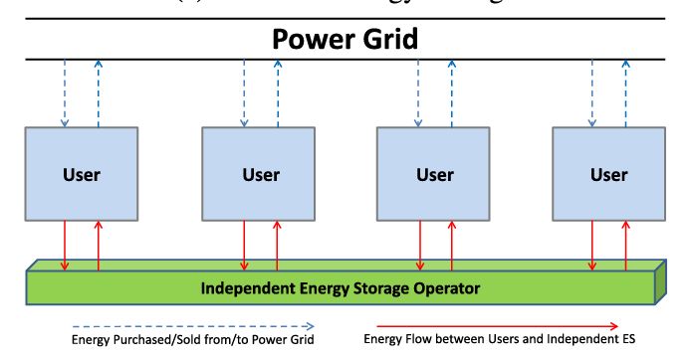
Energy storage sharing architecture
● Independent energy storage:
Shared energy storage is managed by independent operators who determine the storage capacity and price of stored energy. It is suitable for markets that serve many users, such as cloud energy storage, but faces challenges such as price determination, fairness in energy distribution, and balancing conflicts of interest between operators and users.

Slide 13
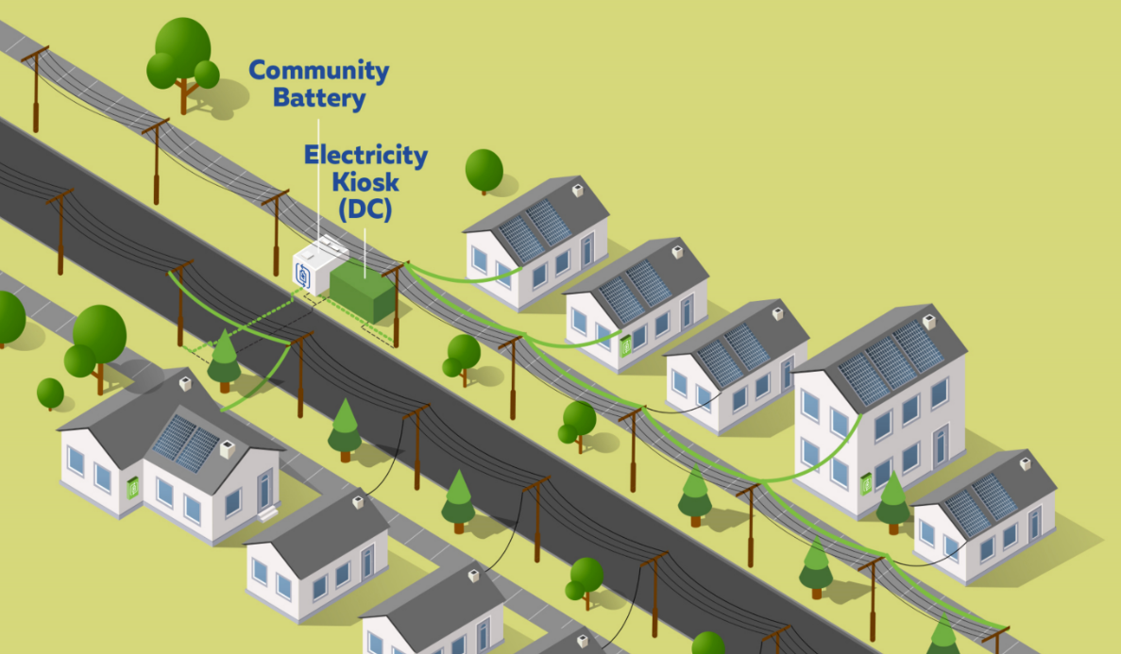
Application scenarios
● Community energy storage:
Providing energy storage services to multiple homes or buildings in a community or neighborhood area. This can be achieved through interconnected energy storage or public energy storage architecture, usually operated by an aggregator.
LED

Slide 14
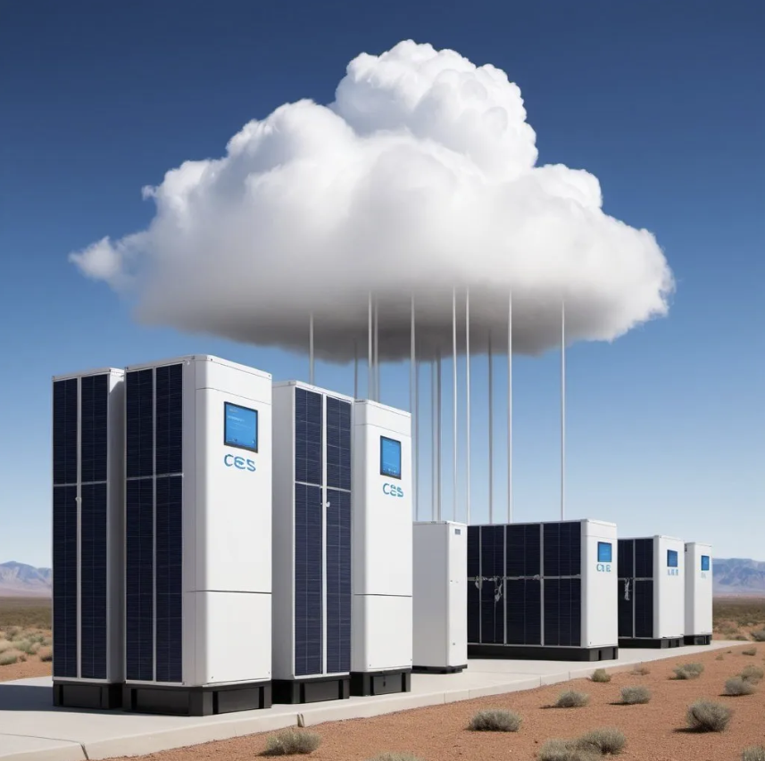
Application scenarios
● Cloud energy storage:
Using cloud computing concepts and combining a variety of energy storage technologies to provide services to a large number of customers in the energy market, it is large-scale, serves a wide range of user types, and has low costs, but only achieves capacity sharing.
LED

Slide 15
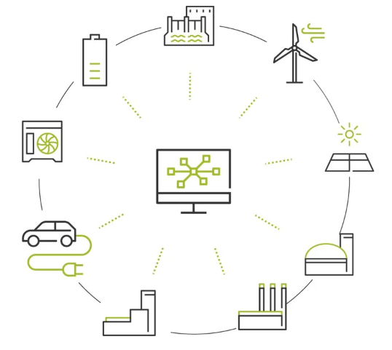
Application scenarios
● Virtual energy storage power plant:
Built by integrating distributed energy storage units and virtualizing the allocation of storage capacity to users.
LED

Slide 16
Application scenarios
● Business models based on the sharing economy:
The application of the sharing economy model to energy storage sharing can enable investors and operators to profit, such as companies investing in energy storage for arbitrage and residents optimizing their energy needs and storage levels.
LED

Slide 17

Integration with other energy technologies
● Integration with renewable energy:
LED
Renewable energy sources such as solar and wind power have intermittent power generation, and integration with shared energy storage can ensure a stable supply. Balancing energy storage is needed to share and support the use of renewable energy.

Slide 18
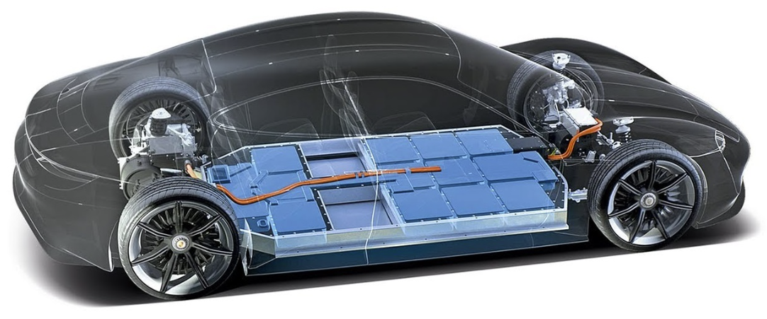
Integration with other energy technologies
● Integration with electric vehicles:
Electric vehicle batteries can be used as shared energy storage or shared energy storage at charging stations, such as using retired batteries to support charging stations, Tesla sharing energy storage at charging stations, etc.
LED

Slide 19
Practical applications and case studies
● Actual projects:
Actual projects include SMUD's Energy StorageShares, Tesla's ConnectedSolutions, and the EU’s SHAR-Q, connecting distributed energy storage for virtual power plants and sustainable energy supply.
LED
● Case studies:
Case studies cover community and cloud energy storage evaluations, including UK and Germany's economic assessments, feasibility analyses, and the benefits of shared energy storage compared to other systems.

Slide 20

Modeling and optimization
of energy storage sharing
● Management Strategies for ES Sharing:
Benefit
Fairness
LED
• Game theory model:
Game Theory is a theoretical framework to study the interactions among the competing players. It can be employed to model the conflicts among the users of ES sharing.
non-cooperative model
independent decisions
energy consumption
battery capacity allocation
Optimize
cooperative model
joint decisions

Slide 21
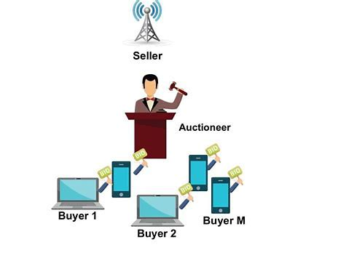
Modeling and optimization
of energy storage sharing
● Management Strategies for ES Sharing:
• Auction model:
Users obtain energy storage resources through competitive bidding to ensure fair sharing of capacity and energy.
• Capacity allocation model:
ES sharing can also be studied as a resource allocation problem by allowing the capacity of the shared ES to be separable. Such models first determine how to allocate the capacity of the shared ES to each user. Then the users independently operate their portion of the ES capacity without exchanging their stored energy.
• Pricing model:
Ensure fairness through appropriate pricing mechanisms and incentivize users to participate in energy storage sharing.
LED

Slide 22
Modeling and optimization
of energy storage sharing
● Determining the scale of shared energy storage:
The appropriate scale of energy storage can reduce costs. Capacity and energy sharing factors need to be considered in shared energy storage systems.
Using random methods or planning models based on the sharing economy to determine the scale of shared energy storage.
LED
● Shared energy storage control:
Develop control strategies to achieve real-time energy management, optimize charging and discharging, coordinate energy storage sharing among different entities, use reinforcement learning to control energy storage, reduce grid congestion, etc.
LED

Slide 23
Modeling and optimization
of energy storage sharing
● Multi-objective optimization:
Apply multi-objective optimization frameworks to solve multi-conflicting objective problems in shared energy storage systems, such as collaborative decision-making frameworks, bi-objective mixed integer linear programming, and multi-objective optimization techniques.
LED
● Uncertainty handling:
Uncertainty is crucial to energy storage sharing management. It includes three forms: random, robust and fuzzy. Currently, fuzzy and uncertain programming have not been applied in energy storage sharing and are future research directions.

Slide 24
Literature Classification
–System Design Dimension
● Architectures & Energy Sharing Types
Architectures
Interconnected: Show connection diagram. In small communities, users share idle capacity. It reduces cost by using existing equipment but has complex coordination.
Common: Present layout of community storage. In large residential areas, it enables centralized management. It needs large initial investment.
Sharing Types
Capacity: Use bar chart to show differences with comprehensive sharing. In industrial parks, enterprises allocate standby capacity.
LED

Slide 25
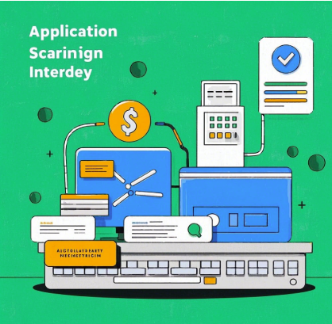
Literature Classification
–System Design Dimension
● Application Scenarios & Energy Integration
Scenarios
Cloud: Display multi-layer architecture. It has a large market share and diverse services compared to others.
Community: show community layout with storage facility and energy transmission lines. It reduces community electricity cost.
LED
Energy Technologies
Renewable (R): Present schematic of combination with storage. Explain how it achieves stable power supply.
Local Generation: Illustrate connection with storage. Describe its role in ensuring power supply for critical loads.

Slide 26

Literature Classification
- Modeling and Optimization Technology Dimension
● Fairness and Decision Frameworks
Fairness and Decision Frameworks
Capacity Allocation: Provide flowchart. It allocates based on demand proportion or priority.
Pricing: Display models and curves. It motivates user behavior.
Decision Frameworks
Cooperative Game: Use case to show cost and benefit changes. Present game tree for decision and allocation.
Non-cooperative Game: Use scatter plot to compare efficiencies. Analyze limitations like resource waste.
LED

Slide 27
Literature Classification
- Modeling and Optimization Technology Dimension
● Mathematical and Solution Technologies
Mathematical Formulas
Multi-level/Stage: Show timeline with decision points. Present formula evolution.
Multi-objective: Use radar chart for weight distribution. Explain solution ideas.
Solution Technologies
Solvers/Algorithms: List common ones and evaluate effects.
Custom: Highlight innovations and define applicable scenarios.
LED

Slide 28

Future Research
-benefit expansion and technology innovation
● Benefit Expansion
For benefit expansion, the quantification of peak shaving and the enhancement of energy storage resilience are studied through curve overlay and chart analysis respectively.
LED

Slide 29

Future Research
● Technology Innovation
In the aspect of non-battery storage technologies, schematic diagrams will be presented to illustrate their principles. Subsequently, a sharing framework will be designed to integrate them into the existing system. For mobile storage, an animation will be utilized to vividly demonstrate the energy flow process. A sharing mechanism flow will be carefully designed, and the application points of technologies for enhancing efficiency will be listed. This will open up new possibilities for the development of shared energy storage.
LED

Slide 30
Research Summary
● Review and Outlook
The research review part will display a mind map that clearly organizes the key concepts related to shared energy storage. Additionally, a keyword cloud will be presented to showcase the prominent research topics. In terms of value and outlook, data charts will be employed to assess the potential growth of shared energy storage. A roadmap will be provided to guide future research directions, indicating the steps and focuses for further exploration.
LED

Slide 31
THANKS

